Slide 1
Current: 36.59$
Target: $45.16 (+23%)
Time Horizon: 12-18 Months
(NYSE:PSN)
Industry Director: Michael Betancur
Analysts: Bricen Fisher, Nirmal Malhotra, Ray Hatton

Slide 2
Company Overview
Business Description
Revenue Breakdown
Parsons is an intelligence and infrastructure company headquartered out of Centreville, VA
Parsons provides tech-based solutions in the defense & infrastructure markets internationally
The company operates in two segments being the Federal Solutions & Critical Infrastructure
Founded in 1944, Parsons retains over 16,000 skilled employees across nine major product lines in 30 countries around the globe
Business Highlights
Geographic Breakdown
The company is headed by CEO Chuck Harrington with 32 years of industry experience
Recent completion of the acquisition of Braxton Science & Tech Group for $300M added to Parsons Space & Geospatial Solutions market
As a part of Parsons COVID Campaign, DetectWise offers touchless health screenings in high traffic areas, adding six clients in the Q3
Parsons won a $51M contract for the 1st DoD ground-based laser system placed into production, totaling Q3 new contracts to $473M
Sources: Investor Presentation, Company Filings, CapitalIQ

Slide 3
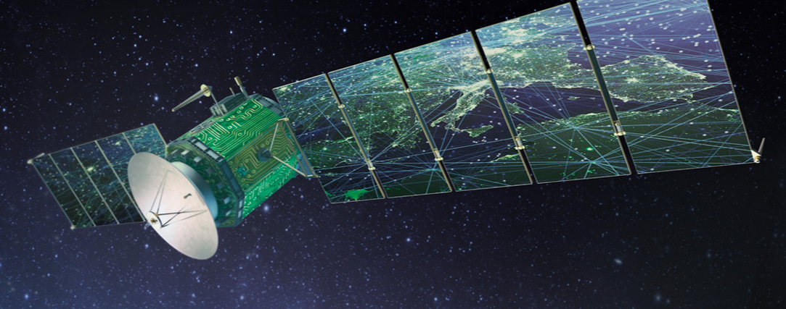

Segment Overview
Federal Solutions
Consists of five business lines being Cyber & Intelligence, Geospatial Solutions, Defense, Mission Solutions and Engineered Systems
These business lines provide cybersecurity, defense systems, space launch & situational awareness, geospatial, & nuclear remediation
Federal Solutions has a book-to-bill ratio of 1.5x with revenue increasing 2.5% YOY to $498M
Parsons has +50yrs of experience working with the Dept. of Energy & +40yrs with the US Army
Critical Infrastructure
Provides integrated engineering for complex physical & digital infrastructure focused on next-gen infrastructure by leveraging data
Customers include the Federal Aviation Administration, DoD, U.S. Intelligence Community, NATO, NASA, Goddard & FEMA
EBITDA margin increased from 7.2% to 10.8% YoY due to favorable contract conditions
Focused on Connected Communities, providing transportation infrastructure for some of the largest cities globally like NYC, LA & Paris
Sources: Investor Presentation, Company Filings CapitalIQ

Slide 4
Financial Overview
52 Week Price Change
Enterprise Value Walkthrough
Post-COVID
$36.59
Financial Highlights
Key Metrics
1. Alongside market correction, PSN is upgraded to buy at Stifel at target of $45
  Analyst Joseph DeNardi upgrades to buy from hold, increases target by $1.00, siting understated EBITDA relative to balance sheet capability for acquisitions
2. Market rallies on hopeful economic outlook
  Combination of stimulus, positive trends in COVID, reopening’s & hopes for a vaccine drove stocks higher
3. EPS increased 7.55% YoY to $0.57
  Rising nearly 8% YoY, EPS rose by $0.24 beating last years Q3 of $0.33, giving shares a boost in November
Market Cap | $3.32B
Debt/Equity | 20.00%
EV/EBITDA | 13.28x
LTM Gross Margin | 21.50%
LTM P/E | 36.63x
5Y Beta | 1.15
4

Slide 5
Industry Overview
Cybersecurity
Cybersecurity Market Size ($Bn)
The United States federal cybersecurity market is projected to reach $22 billion by the year 2022, growing at a CAGR of over 12%
M2M interaction in Retail, Banking, Telecom, IT, Healthcare, Automotive growing at 5.5% CAGR
Rapid development of cybersecurity industry, as implementing technical defenses has become a standard best practice in every enterprise
In 2019, 1,473 data breaches occurred in the US with over 165 million records exposed
Smart Cities
Connected Communities Market Size ($Bn)
By 2030, the world is projected to have 43 megacities with +10 million inhabitants, most of them in new and developing regions
Emerging economies are expected to offer new market opportunities in connected communities
Average contract amount per mile for improvements is $400 with 4.3 million miles of road across the United States
With $88 billion in productivity lost to congestion, Parson cities have seen up to a 40% reduction in traffic delay from updated tech
5
Notes:
Huntington Ingalls is working with Boeing to fulfill a contract for UV but not

Slide 6
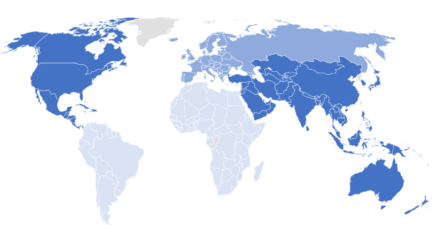
Investment Rationale
Parsons strong financial health ensures growth
  Diverse revenue streams, exposure to other industries and to emerging markets: Asia (1), Latin America (1), Middle East (7)
  Completed +12 strategic acquisitions since 2011 expanding product offerings and market exposure
  Current debt-to-equity ratio of .48 and a quick ratio of 1.61
PSN Backlog/Revenue
New COVID virtual touchless health campaigns represent entrance to new growth market
  PSN product DetectWise implements screening kiosks and modular testing infrastructures
  PSN was awarded a $50M contract to extend pre-existing work with the Houston Airports IAH systems to implement health facilities
Global Healthcare Mobility ($B)
CAGR 20.4%
Increased focus on critical and evolving space market as well as geospatial
  PSNs Braxton allows to capitalize in low earth orbit constellations, small satellites, and space cyber
  For 2021 Braxton is expecting earnings of $133M
  Pearl product operates manned/unmanned platforms providing imagery of 4 centimeters from 10,000ft above and has been deployed by SOCOM
Spacecraft Market Global Growth Rate
Sources: Company Website, Company Presentation, CapitalIQ, GrandViewResearch, MordorIntelligence

Slide 7
Investment Rationale
Parsons is poised to capture trends in the high growth cybersecurity market
  Estimated $600B annual global cost impact from hacks, cyber criminals, corporate espionage, etc.
  68% of US businesses have not purchased any form of cyber coverage
  Increased demand through federal directives: Executive Order 13636, Presidential Policy Directive 8 & 21, National Infrastructure Protection Plan (NIPP), HSPD-7
  70% of breaches start at endpoints despite competitors focusing on prevention, PSN focuses on detection, monitoring, and endpoints
Products and services address underlying issues
  Implementing SharkSeer 2.0 as of October through a $28M deal with DISA and DoD
  PacketWolf ensures zero packet transfer loss, up to 4.8B packets per second, optimization through IPv4, IPv6, TCP Port, UDP Port, 30-tuple, and 5-tuple
  Qp2 enables cloud service applicable user interfaces for increased resilience
  Japan has the lowest mobile malware infections at 1.34% due to urban efficient environments such as Smart Cities
Global Industry Sector Malware Incidents
Industrial Revolution 4.0 Transformation
Top AI Use In Cybersecurity
Sources: Company Website, Company Presentation, CapitalIQ, Statista, FinancesOnline, SalesForce

Slide 8
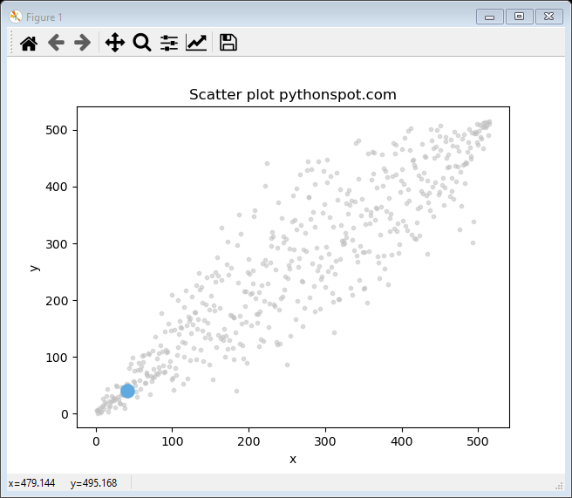
Investment Rationale
Set to seize growth through “Smart Cities”
  By 2023 expected 100 smart streetlight projects and 88 smart parking projects
  PSN received a $224 million contract for Riyadh Metro. The worlds longest ongoing metro project
  PSN Genesis Competition pooled +50 cities from US, Canada, and the Middle East
  To battle climate issues such as wildfires and power outages, PSN sells Formed Grid Armor and PSN recently worked to rebuild U.S. Navy in China Lake after a 7.1 magnitude earthquake
Strong operations in transportation
  PSN has linked +63k devices and +12k traffic lights across the United States
  PSN iNet reduced traffic delays by 15-40% through updated signals, reduced 4.9B tons of greenhouse gasses, saved $27B in productivity. Used in +40 cities making it the most operated traffic software
  Denver’s PSN Smart City switch will recover costs within about 3 years and projects them as the 5th highest growth large city and 41st overall
  $32M San Bernardino County Transportation to improve freeways, interchanges, grade separations, and other projects
Total US Smart Cities Project Revenue ($M)
CAGR 42.7%
Urbanization and Infrastructure
City Infrastructure (+)
Sources: Company Website, Company Presentation, CapitalIQ, Statistica, WalletHub, U.S. Census Bureau

Slide 9


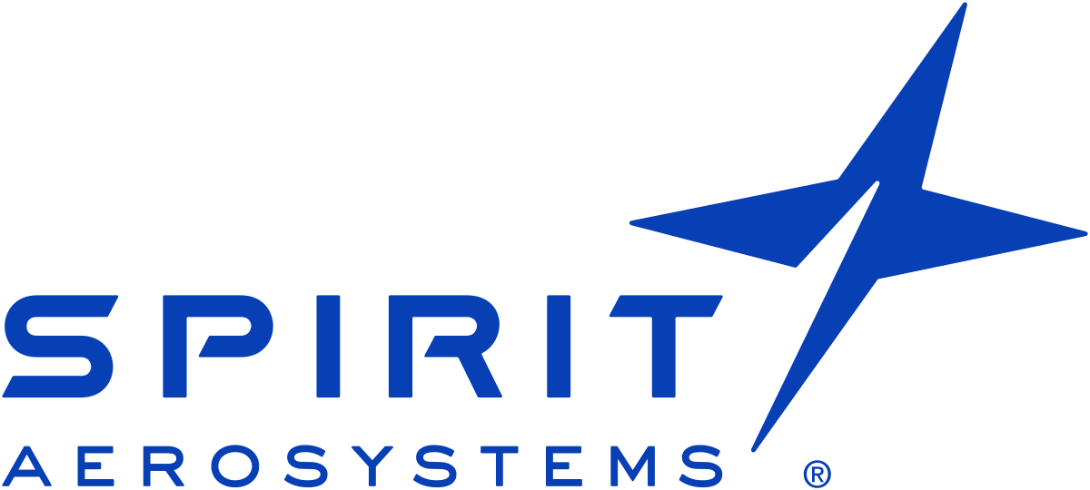
Competitive Landscape
Mkt Cap | 14,794
N.I. Margin | 5.1%
Quick Ratio | 1.1x
Mkt Cap | 5,471
N.I. Margin | 3.0%
Quick Ratio | 1.03x
Mkt Cap | 3,765
N.I. Margin | -11.3%
Quick Ratio | 2.41x
Provides solutions for IT, engineering, and science
LDOS competes with PSN in cybersecurity, artificial intelligence, health, and other sectors
LDOS has a high debt to equity ratio of 121.6% compared to PSN’s 33.2%
PSN has a gross profit margin of 21.5% compared to LDOS’s gross profit margin of 13.9%
SAIC offers engineering, technology, and equipment platform integration
SAIC competes against PSN in artificial intelligence, cybersecurity, and other technologies
SAIC’s earnings growth has been ~10% VS PSN’s ~17%
PSN has a gross profit margin of 21.5% is nearly double of SAIC’s gross profit margin of 11.0%
Offers solutions for fuselage systems, propulsion systems, and wing systems
SPR largely competes in the aviation sector. PSN provides solutions in the commercial aviation sector
SPR revenue collapsed by 68% in 2Q20 YoY VS PSN’s revenue decrease of 1% in 2Q20 YoY
Airline carriers are rebounding but are still scaling back plans to update fleets. SPR concentrated in this segment will have a slow recovery
Sources: Capital IQ, Investor Presentations

Slide 10
Public Comparables

Slide 11
DCF

Slide 12
DCF Output

Slide 13
Football Field Analysis

Slide 14
Potential Risks
The commercial aviation market has taken a drastic downturn
Mitigant: Parson’s countless acquisitions over the years has allowed it not to be dependent on one segment. Parson is highly competitive in cybersecurity, artificial intelligence, machine learning, Internet of Things ( IoT ), and smart city solutions
Military spending may stagnate under a Joe Biden presidency
Mitigant: Although military spending may stagnate, Joe Biden has expressed interest in increasing investment into fields such as cyber security and artificial intelligence. Joe Biden is planning to reinstate a white house cyber security position and increase non-military federal spending (+$300 over four years) on artificial intelligence
Widespread migration from urban cities creates pressure against the movement towards smart cities.
Mitigant: There’s been a movement away from cities such as New York, and Los Angles but a movement in cities like Austin, Atlanta, and Denver. Some of these growing cities are allowing Parsons to expand operations
Mitigant: According to Joe Biden’s campaign website, He wants to invest $1.3 trillion dollars over the next 10 years in American infrastructure. This plan includes smart cities and their upcoming importance in the future. Parson’s fierce innovation in the smart city market will set them up to be a significant competitor
Sources: Capital IQ, Investor Presentations, Company Website, JoeBiden.com, Politico , Fourtune

Slide 15
Q&A

Slide 16
Appendix

Slide 17
Appendix

Slide 18
Appendix

Slide 19
Appendix

Slide 20
Appendix

Slide 21
Appendix
EV/EBITDA Valuation
P/E Valuation

